Slide 1
Kanha Baidya

Slide 2
REAL ESTATE INFLATION & ITS IMPACT
HOME PRICE INFLATION

Slide 3
Agenda
Introduction
National house price growth
Region and state wise house price growth
Correlation between HPI and median household income
HPI growth % to inflation relation and COVID impact
Conclusion/summery

Slide 4
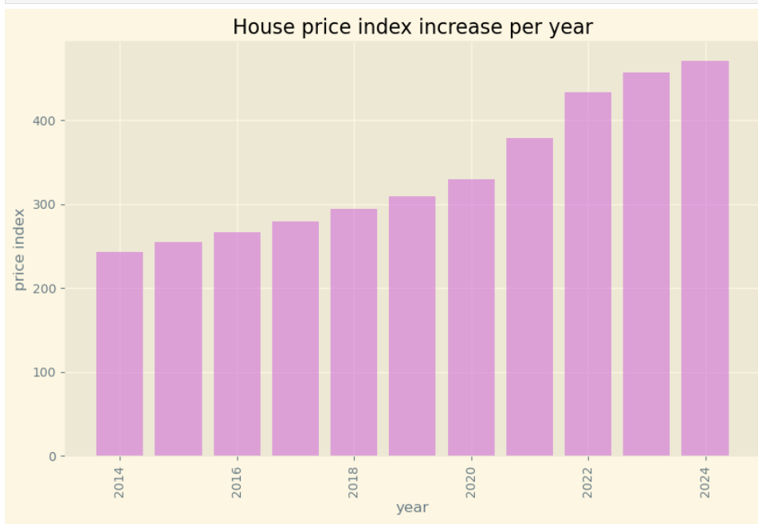
NATIONAL HOUSE PRICE GROWTH
In this graph we can see that house price index in usa is increasing in every year
In 2014 the house is 250 is now 400

Slide 5
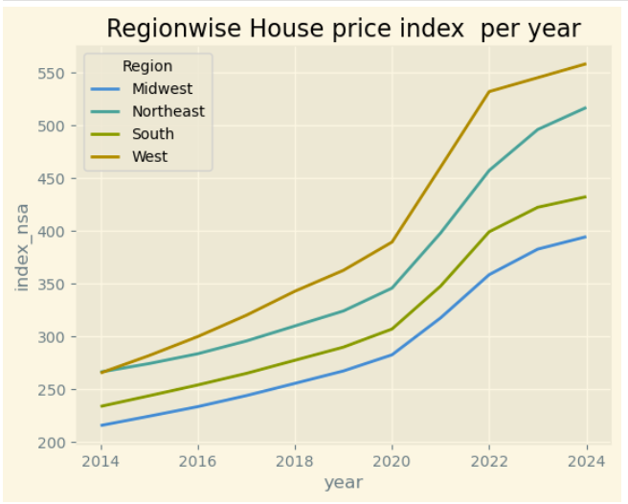
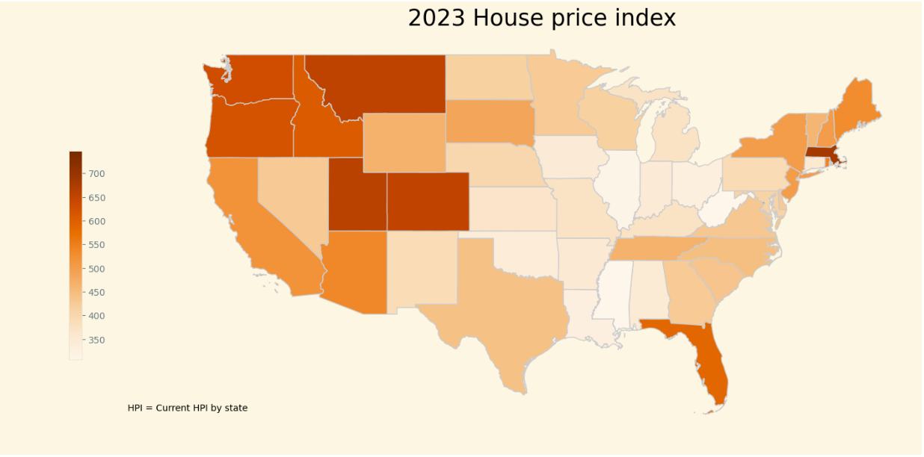
HPI GROWTH IN US REGIONS & STATES
In this graph we can see in the west region of usa hpi is higher than south region.
In covid period since 2020 HPI has stiff increase for all region, but west and northeast experienced higher growth compared to south and west
In this heatmap we can see for 2023 west region hpi is higher than another region.
In south region Florida hpi is higher than other
In northeast ma hpi is higher than other states

Slide 6
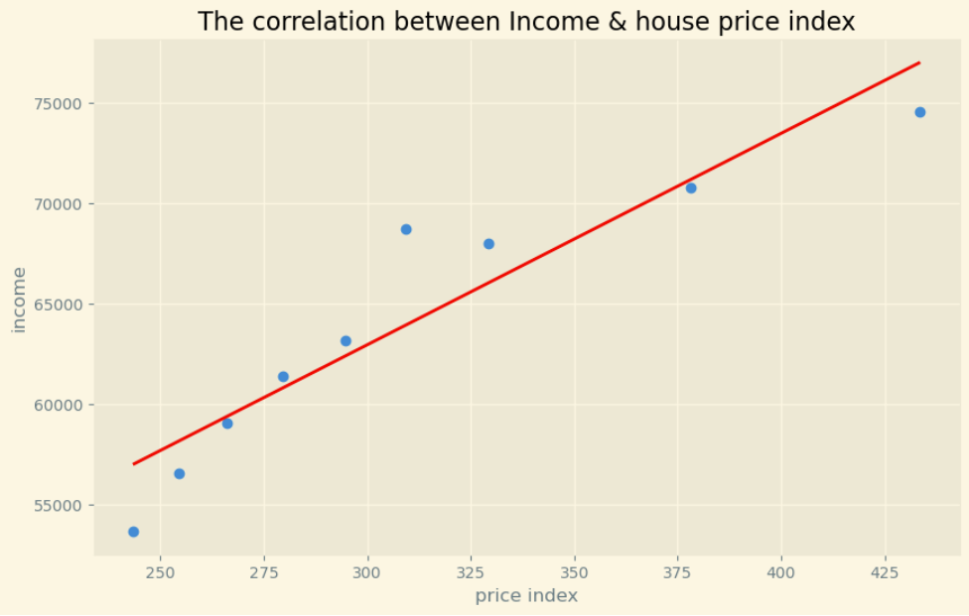
A correlation rate of 0.94 between median household income and HPI (Housing Price Index) indicates a very strong positive correlation between these two variables.
A correlation coefficient of 0.94 suggests that as median household income increases, the HPI also tends to increase. This high positive correlation indicates a strong relationship between the two variables, meaning that they move in the same direction together.

Slide 7
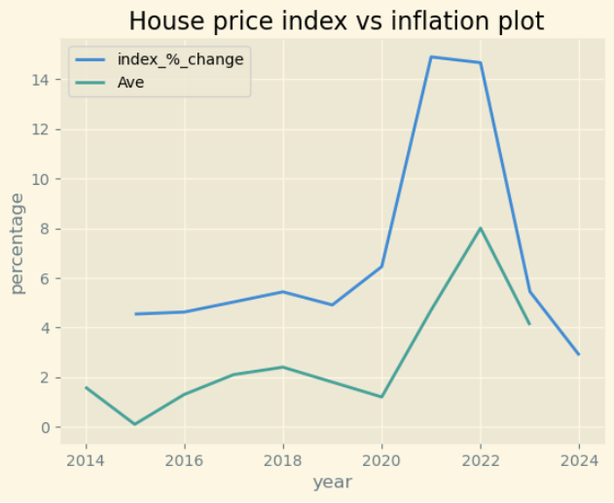
House price index is in parity with general inflation and COVID and post COVID effect has aggravated the increase

Slide 8
CONCLUSION
After this data analysis we observe that nationwide HPI is increasing. Not only nationwide region & statewide also HPI increasing by year.
We also observe that the rate HPI is increasing median household income is not increasing the same way. So, the affordability of buying a house is decreasing.
At per with general inflation, Home price inflation or real estate inflation is also increasing.

Slide 9

Referrence:
https://www.fhfa.gov/data/hpi/datasets?tab=additional-data
https://tradingeconomics.com/united-states/average-house-prices
https://www.fhfa.gov/data/hpi/datasets?tab=additional-data
https://www.rentdata.org/states/2020
https://fred.stlouisfed.org/categories/27312?t=annual&ob=pv&od=desc
https://tradingeconomics.com/united-states/price-to-rent-ratio
https://www.forbes.com/sites/qai/2023/01/02/is-inflation-high-compared-to-years- past-breaking-down-inflation-rates-by-year/
https://www.statista.com/statistics/200838/median-household-income-in-the-united-states/

Slide 10
THANK YOU
Kanha Baidya
08-Aug-2024

